Slide 1
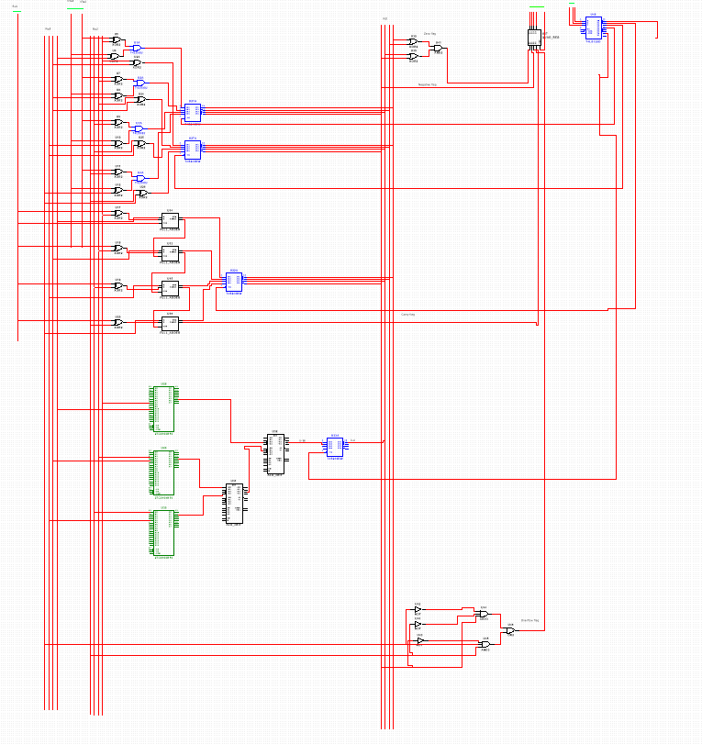
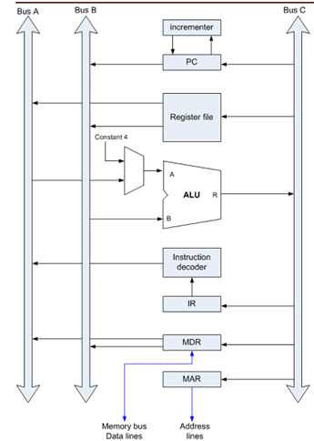
The ALU
This design is based on the image below, all register content transfers occur through the alu so that data transfer and arithmetic operations can occur simultaneously

Slide 2
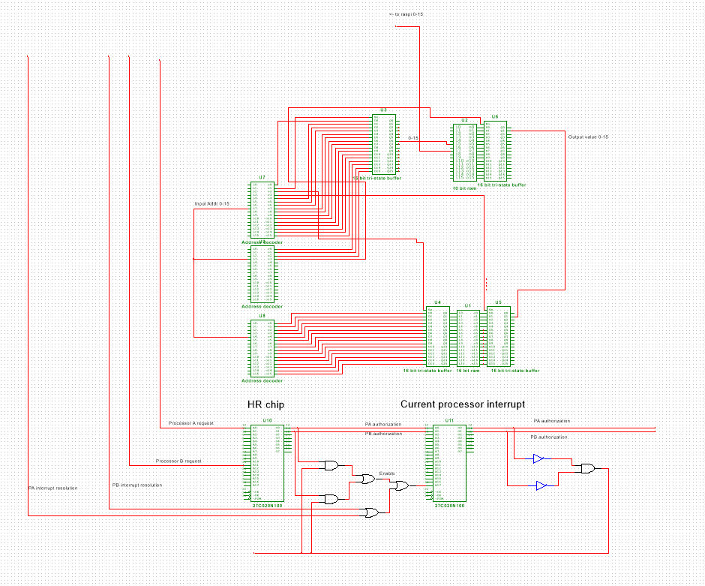
The Ram/rom module
Rom is incorporated into the ram module so that the computer could initiate a default program upon startup. Also, a system which allows multiple processors to access the ram module is seen as well. A processor will go into a waiting state until the system decides that it is allowed access to ram. Afterwards, an interrupt will break the wait operation and allow the processor to access main memory.

Slide 3
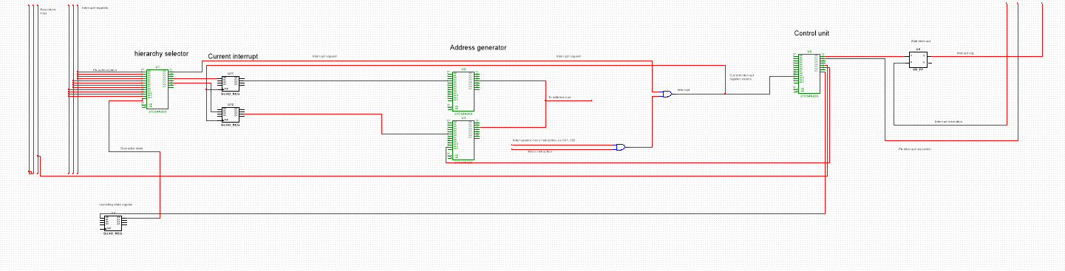
Interrupt module Every instruction has the capability to become an interrupt instruction given certain conditions; i.e. specific micro instruction, processor is interruptible, etc. Some circuitry is present which saves the currently executed interrupt in memory to remove the risk of a higher prioritized interrupt suddenly becoming requested and stealing another interrupt’s handling.

Slide 4
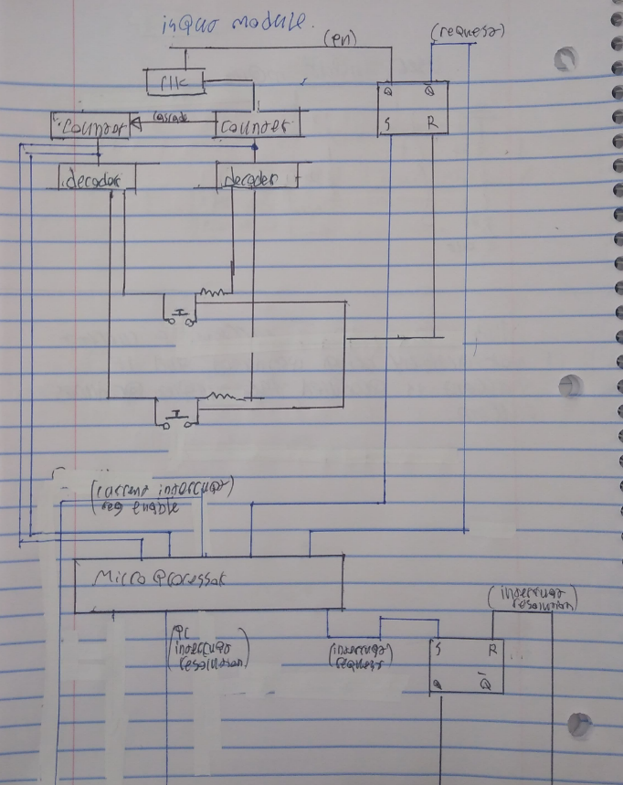
Keyboard module I plan on either removing the circuitry of an existing keyboard and using the keys + board for my design, or just implementing the design by use of switches. This peripheral device interfaces with the main processor's memory via the ram accessing circuitry seen in the ram module.

Slide 5
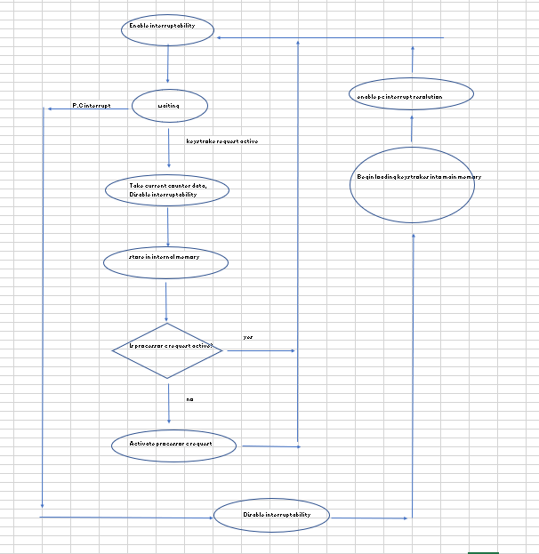
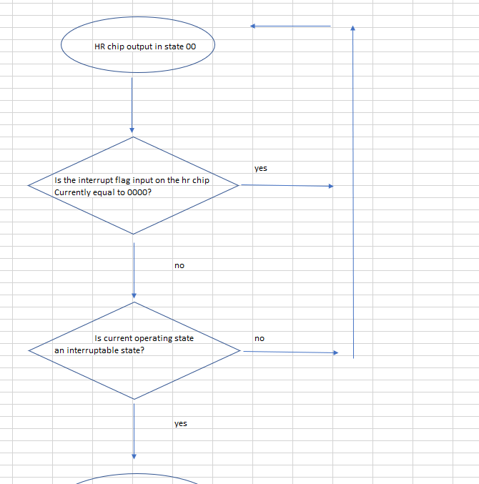
Planning To ensure proper, edge-case tested operation of my computer, I plan on creating a flowchart for the more complex modules. Pictured are the flowcharts for the Ram/rom module, and the Keyboard module.

Slide 6
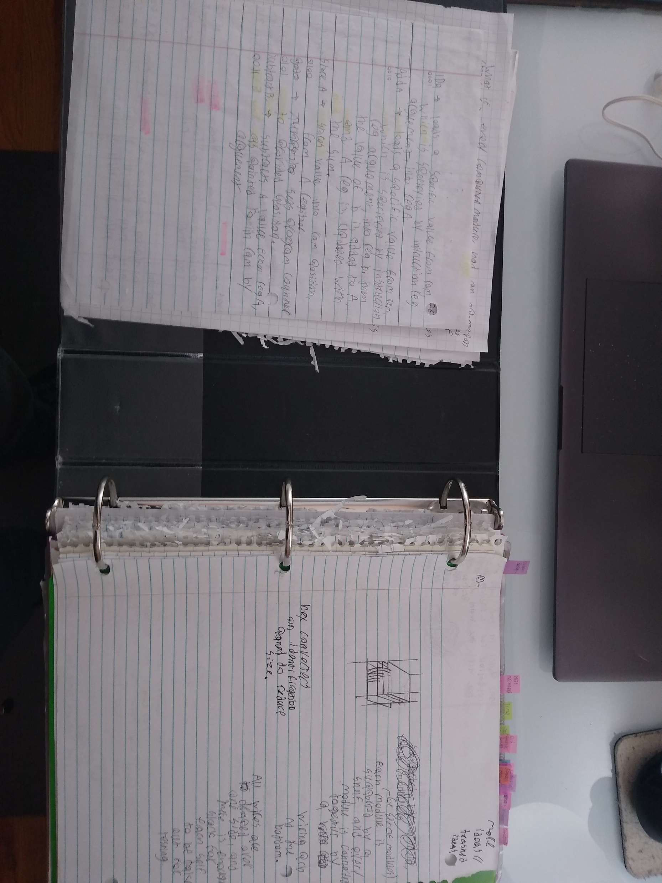
Work in progress I have many ideas for this project that are excluded from my GitHub due to time constraints. What you see in this presentation only represents a portion of the work I have put into this project.

